Slide 1


Paid Search Advertising & Analytics
Unit 10: Homework
Prepared By Nazia Rothy

Slide 2
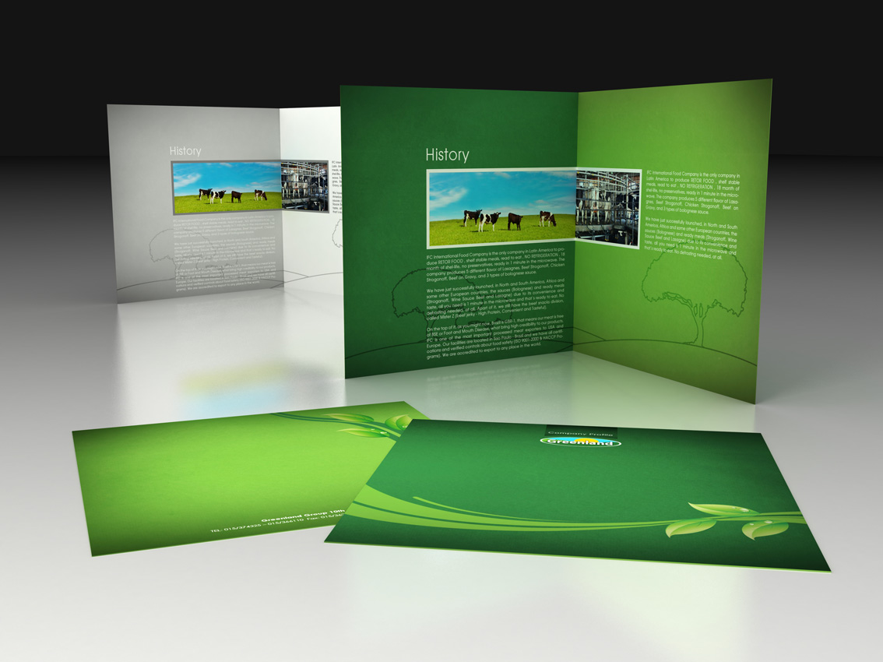
Business Description
Prairie Adventure Tour is a reputable and responsible Saskatchewan travel agency and tour operator. We provide a carefully curated menu of vacation and holiday packages, as well as a comprehensive list of tourist attractions in Western Canada.
We provide cutting-edge solutions that keep travellers safe and productive while also guiding them in making knowledgeable decisions on the trip.
Google Ads can assist us in acquiring more guests and selling more excursions/vacation packages tailored for customers of various ages.
So, if you choose Prairie Adventure Tour, you will have the opportunity to experience high-quality tours, amazing guides, and fantastic experiences both in summer and fall in lovely Saskatchewan locations!

Slide 3

 | Students/New Professionals | Young Professionals | High professional & Nature Lover
Demographic
Age | 18-24 | 25-40 | 45-65+
Gender | Male & Female | Male & Female | Male & Female
Income | 20k-35k | 55k-85k | 90k+
Psychographic
Lifestyles | They lead a highly busy life filled with personal & professional development, enter into job life as well as active participation and exploration of new things, always want change. | Their style of life is making an impact in many aspects of life, including social, professional, political, and economic. Very enthusiastic and looking forward to new experiences. Nature lover. | They are resourceful, have a good work-life balance, and live a steady existence. They spend time speaking and dealing with religious and traditional ideas. They are good at adapting to change and motivating others.
Values & Attitude | Explore diverse career, Experience the beauty of life, Saving attitude. | Integrity, responsibility, ambition & coherence in professional & personal life, Determination, More engagement with Family. | Growth and personal development, Interaction, More engagement in religion and tradition.
Hobbies/ Interests | Hiking, Cycling and outdoor activities | Gym, Travelling, Photography | Reading, Gardening, Watch TV, Vacation spends with FnF in different places, specially with grandchildren after 60+
Target Audience

Slide 4
 | Students/New Professionals | Young Professionals | High professional & Nature Lover
Geographic
Country | Canada & USA | Canada & Sothern part of America | Canada
Behavioural
Usage | They are more digitalized and spend money on gaming, online shopping, and online subscriptions. | They enjoy spending money and are constantly on the lookout for new businesses to connect with on social media and become a partially committed consumer. Climate change, wildlife extinctions, and science and technology are all topics that they are interested in. | They spend on children, grandchildren, dependent parents and social welfare.
Brand Loyalty | They want to try out new brands, and their brand loyalty and brand choices differ depending on the product category. | This group of people becomes Roamers and is more likely to like to shop around, perhaps due to increased financial limitations as their family expands. | Before retirement, they become loyal; after 60, they revert to being Roamers, maybe looking about for the greatest deals to better serve a set income.
Online Activities | Snapchat, Tok-tok, Instagram, You-tube, Pinterest | Facebook, Tweeter, Instagram, LinkedIn | Facebook, Email
Target Audience (Cont.)

Slide 5
Target Audience: Customer Persona
Mathew
Sandra
George
Age | 22 Years | 38 Years | 63 Years
Location | Toronto | Montana, USA | Calgary, Alberta
Occupation | Bank Teller | Restaurant Manager | Professor
Finances | $35,000 | $75,000 | $145,000
Personal Status | Single | Married having 2kids | Married, lives with wife having 2 Sons and 2 Grandchildren
Frustration | Attempted to travel with friends but did not receive adequate quality services from a tour agency. | She was in difficulty since she was preparing a vacation for her sister's wedding. | Became frustrated about the travel agencies after a trip in USA.
Interests | Spending money on experiences rather than "things" is preferred. (For example, Mathew is saving money for a month's vacation in Calgary, Alberta, in the coming summer.) | She enjoys spending time with her family whenever she has the opportunity. But she Enjoys hiking, swimming and canoeing in time of vacation. She likes excursions with kids. | During the Christmas, he enjoys travelling to other regions to spend time with his grandkids.
Channels | Likes to spend time on Instagram, Facebook, Tiktok, Pinterest and Twitter | Active networking on Facebook, Instagram and LinkedIn. | LinkedIn, email
Our Goal | Briefly describe our offers and services through Facebook /Instagram ads. | Make a trip planner available through a paid search campaign. | Provide various regional seasonal offers using email marketing,

Slide 6

Goal
Building brand awareness, developing a strong digital and physical presence in our community, and increasing subscription numbers are all goals for us. These will be accomplished through a strong social media presence, paid advertising, and search engine optimization of our website.
Objectives
Increase the rate of website traffic by 25% in the following six months.
Tactics
Insert dynamic CTAs into blog entries to publish more relevant CTAs.
Create one in-depth article every month to increase traffic from long-tail keywords.
Use Facebook/ Instagram marketing to drive people to in-depth blog entries.
Increase revenue by 20% by the Quarter-3.
Tactics
Targeted Ad on Facebook, Instagram & Tik Tok to promote the new campaign, offers and destination packages using competitive analysis.
Request customer recommendations.
Email marketing to the newsletter signed up clients.
Increase the relationship with influencers (e.g., Travellers, Wedding planner, Corporate event organizer etc.) in order to escalate the brand’s social media presence.

Slide 7

KPIs of Google Ads Campaign

Slide 8
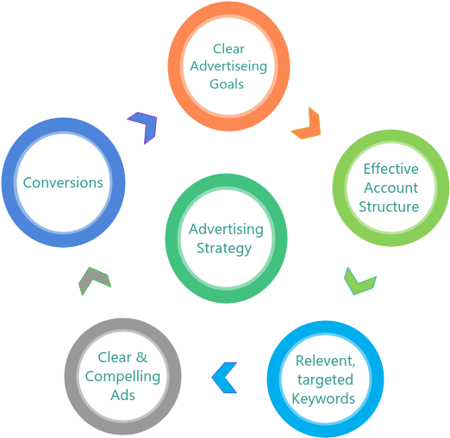
Best Practices for website traffic(Brand Campaigns)
Fig: Advertising Strategy to achieve the KPI Objectives for Prairie Adventure Tour
KPI for objective-1:
Achieve the highest possible CPC (Cost per Click) within a daily minimum budget .
In the following three months, increase website traffic by web hosting and service visibility.
Metrics:
To achieve the highest possible CPC per day minimum budget of CA$15.00.
Increasing the usual volume of web traffic by 20 times at a certain timespan.

Slide 9
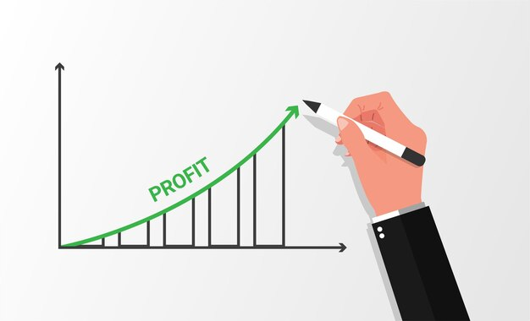
Best Practices for Increasing Revenue Campaigns
KPI for objective-2:
Obtain the maximum possible revenue within an average daily budget.
Acquiring the highest ROI (Return on Investment) from specified advertisements campaign.
Metrics:
To attain the best achievable Revenue on Ad Spend (ROAS) per day average budget of CA$20.00 (Approx.).
Increasing the capital investment in user choice campaigns to attain the ROI.

Slide 10
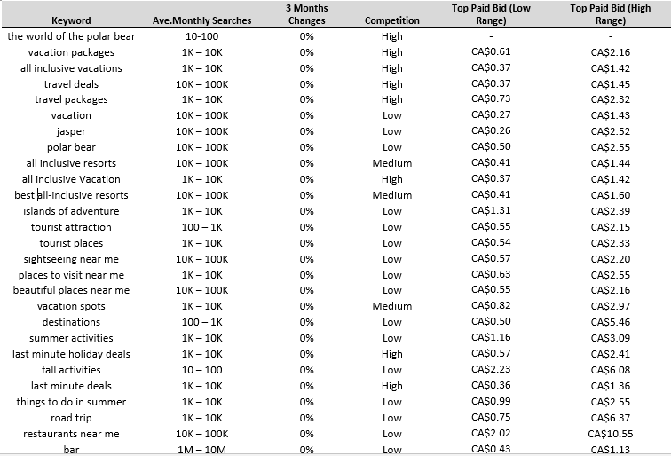
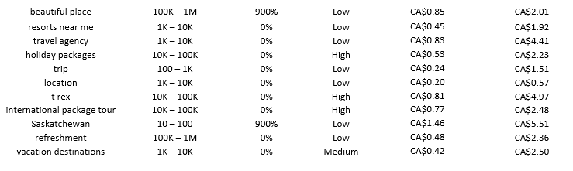
List of Keywords

Slide 11
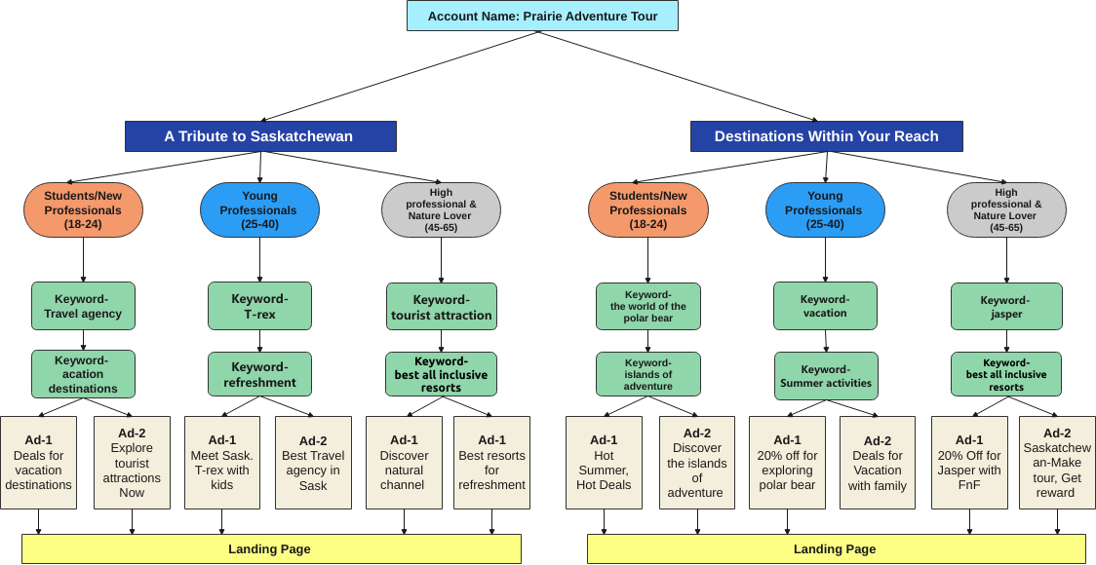
Google Ads Campaign Structure
Objective-1: Increase the rate of website traffic by 25% in the following six months.

Slide 12
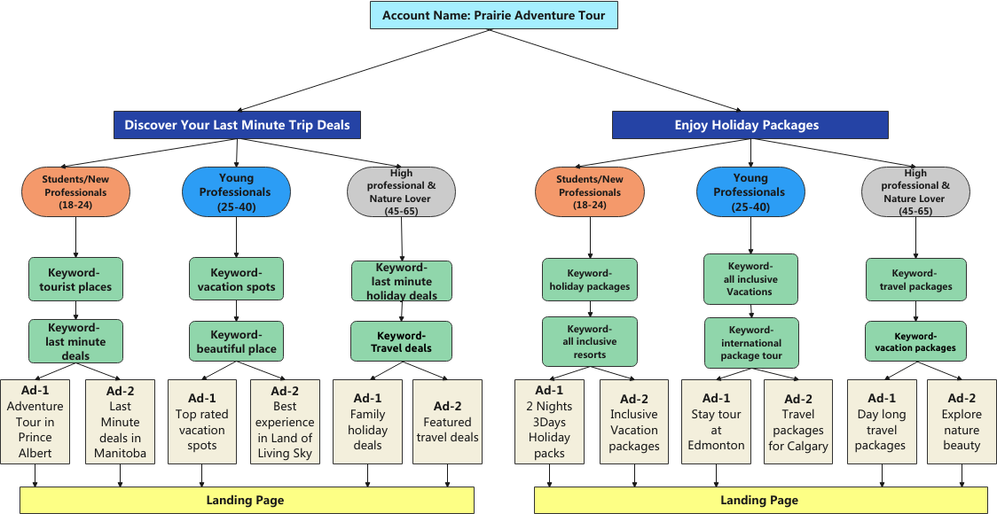
Google Ads Campaign Structure (Cont.)
Objective-2: Increase revenue by 20% by the Quarter-3.

Slide 13
Analysis for Campaign Structure
Organize Targeting
New Audience Creation
Maximize the web trafficking
Ensuring quality assurance
Analyzing the customers’ or stakeholders’ needs
Budgeting
Make an Annual budget for bidding
Try to balance the profit margin
Gain the quarterly objective by valuing the service
Service of high quality at the lowest possible cost
Future Optimization
Making a future brand
Excellent and trustworthy travel agency
Create marketing or promotion campaigns in accordance with appropriate sectors
Partnership for brand promotion
Objective-1: Increase the rate of website traffic by 25% in the following six months.

Slide 14
Analysis for Campaign Structure (Cont.)
Organize Targeting
Offerings can be divided based on age categories
Developing innovative ads in order to increase client involvement
Using specific familiar keywords in Google Ads
Budgeting
Make a yearly budget for keyword bidding and developing relevant services and offers Ads
Incorporate more marketing and promotion into the quarterly budget
Ensuring effective use of the quarterly budget
Audit and analyze revenue data for each quarter
Future Optimization
Making specific offerings and services for the 25-40 age category
Promoting adventure tours by creating attractive ads for adventure lovers
Making personalized travel plans based on the interests of the customers
Strengthen partnership for retargeting new customers through other brands.
Objective-2: Increase revenue by 20% by the Quarter-3.

Slide 15
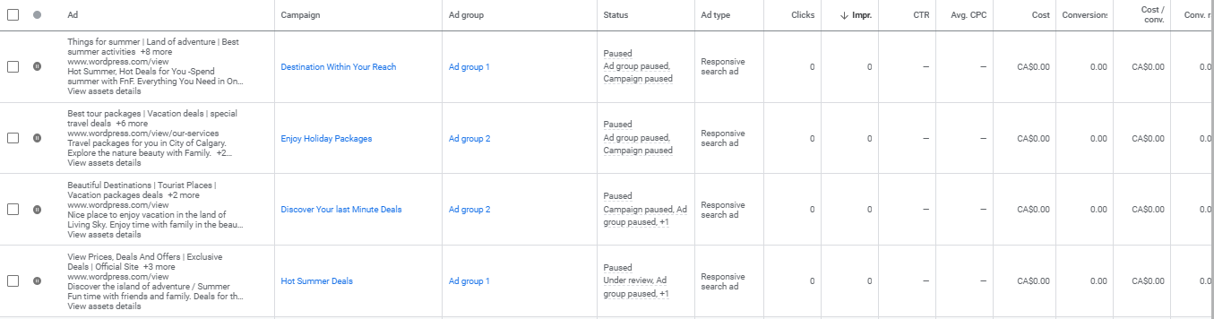
Selective Ad Group Advertisements
There are 16 Ads Groups based on my Campaign Structure

Slide 16
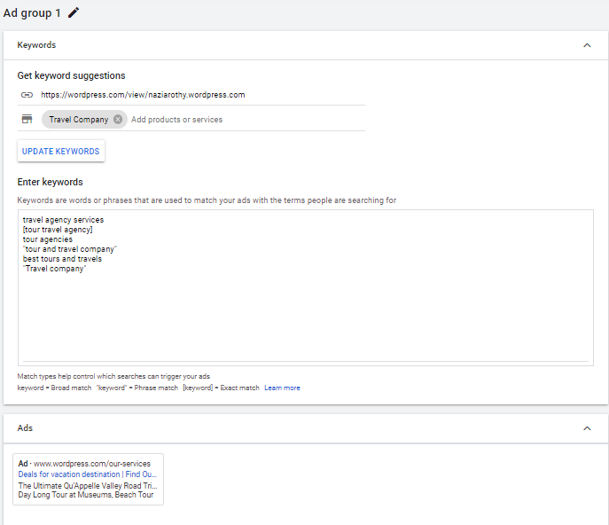
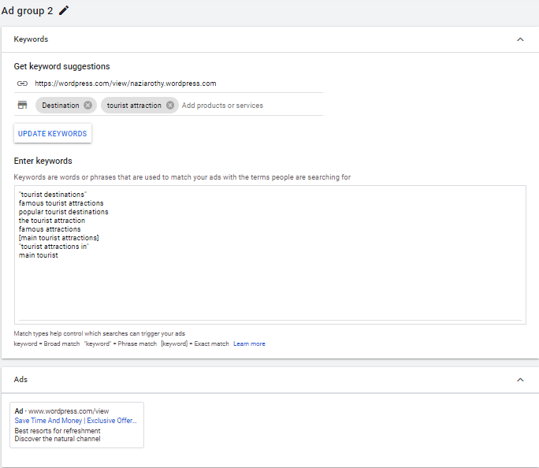
Selective Ad Group Advertisements
Campaign Name: A Tribute to Saskatchewan
There are 16 Ads Groups based on my Campaign Structure

Slide 17
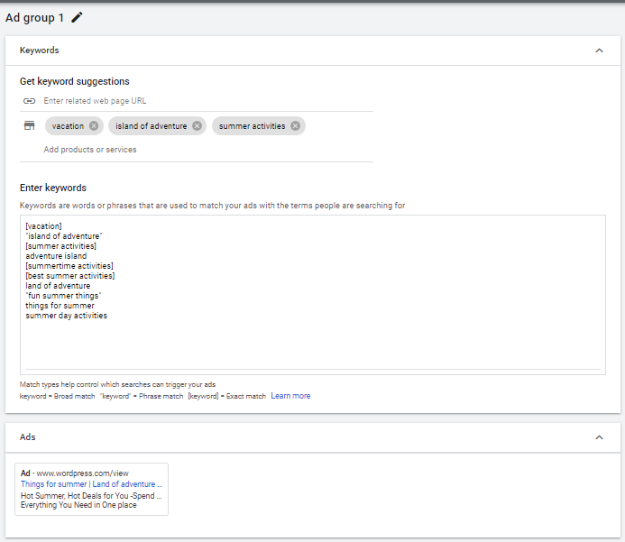
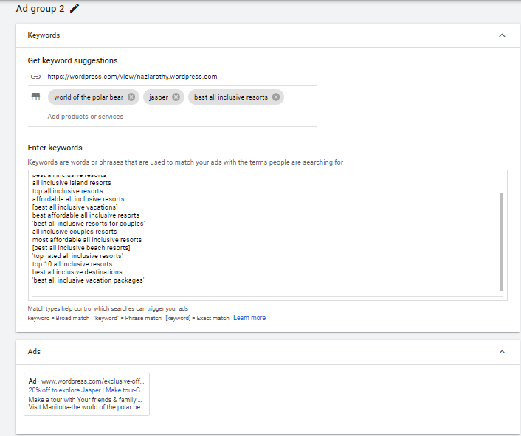
Selective Ad Group Advertisements (Cont.)
Campaign Name: Destinations Within Your Reach
There are 16 Ads Groups based on my Campaign Structure

Slide 18
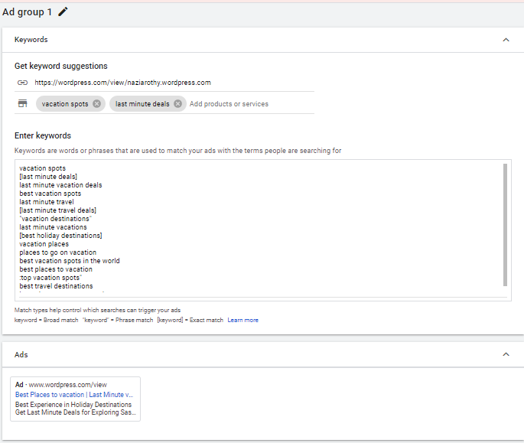
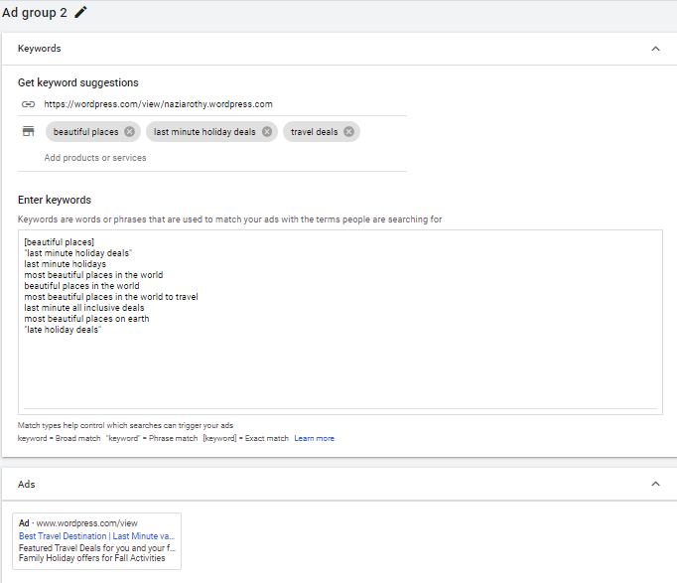
Selective Ad Group Advertisements (Cont.)
Campaign Name: Discover Your Last Minute Trip Deals
There are 16 Ads Groups based on my Campaign Structure

Slide 19
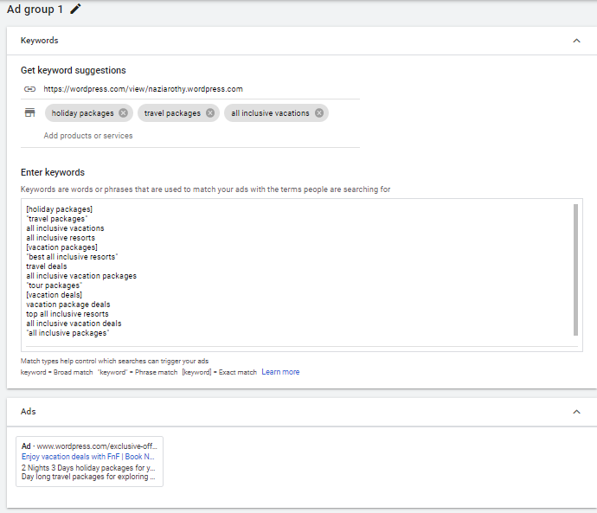
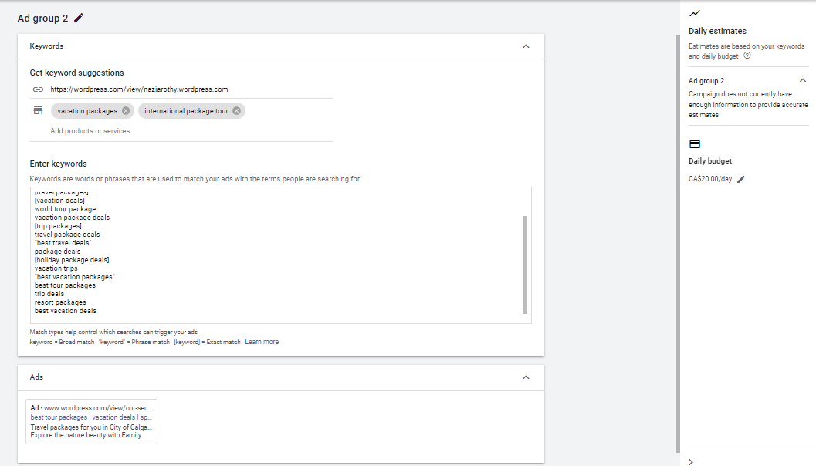
Selective Ad Group Advertisements (Cont.)
Campaign Name: Enjoy Holiday Packages
There are 16 Ads Groups based on my Campaign Structure

Slide 20
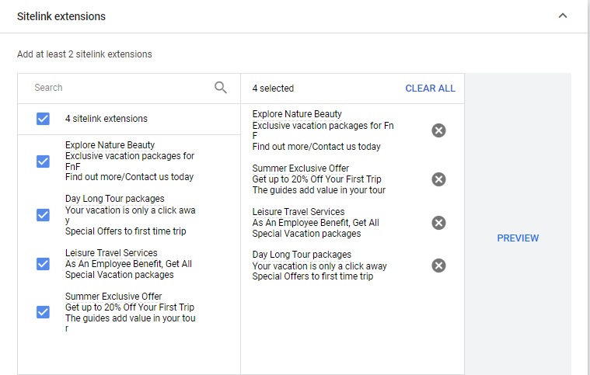
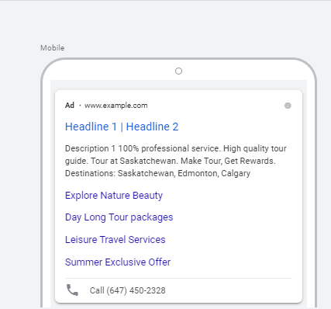
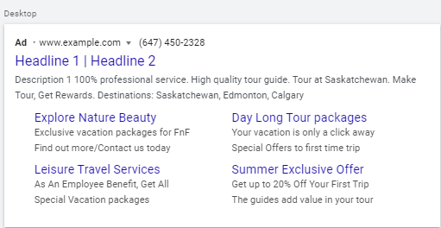
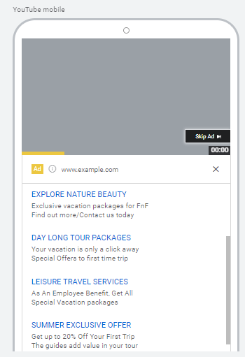
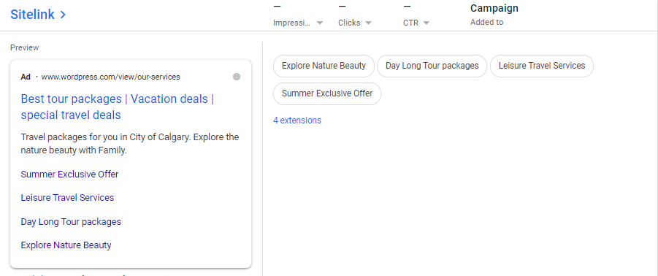
Ad Extensions in Advertisement
Campaign Name: Enjoy Holiday Packages
Sitelink Extensions
Mobile Preview
Desktop Preview
Preview-3

Slide 21
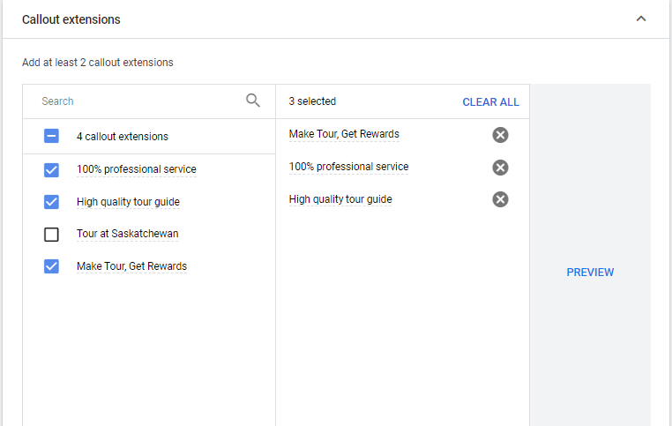
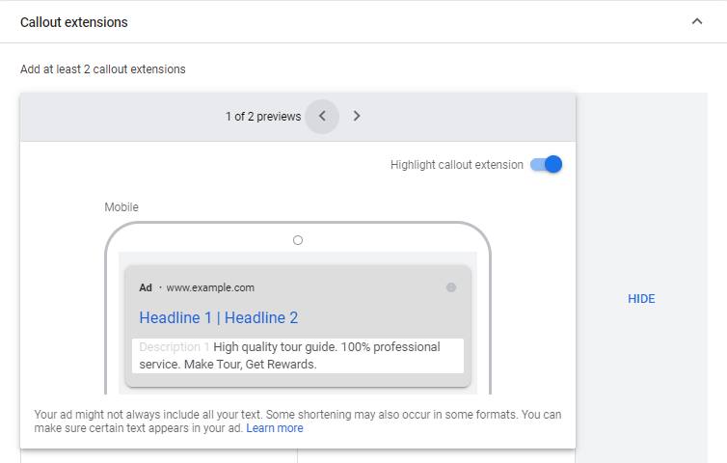
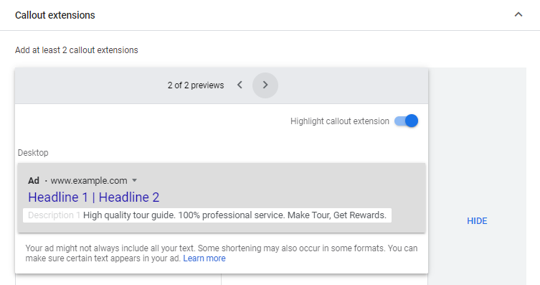
Ad Extensions in Advertisement (Cont.)
Callout Extensions
Mobile Preview
Desktop Preview

Slide 22
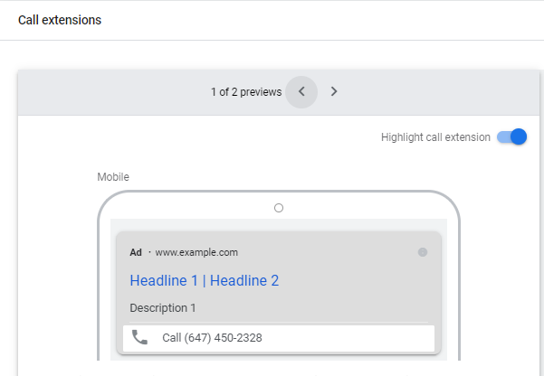
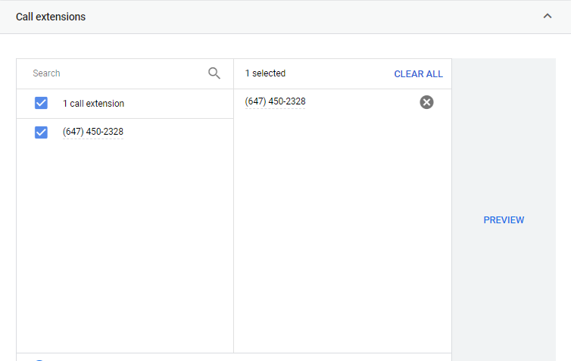
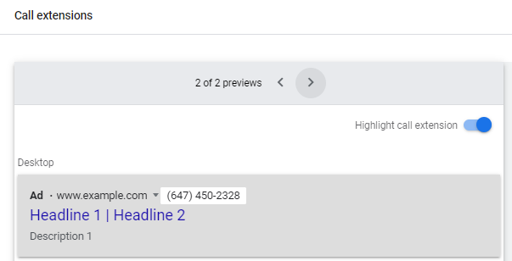
Ad Extensions in Advertisement (Cont.)
Call Extension
Mobile Preview
Desktop Preview

Slide 23
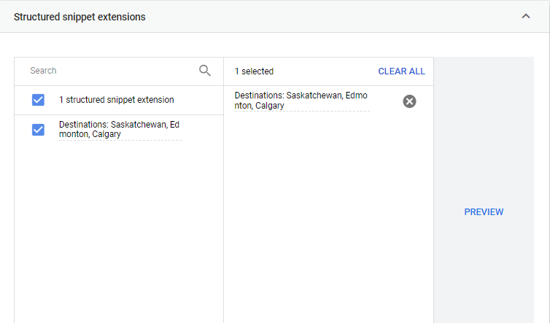
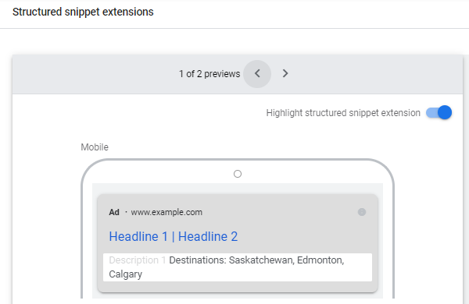
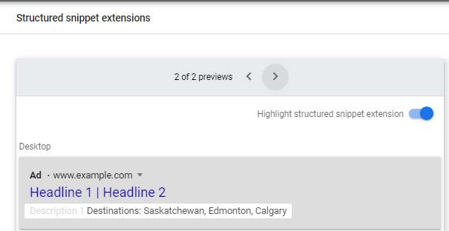
Ad Extensions in Advertisement (Cont.)
Structured Snippet Extension
Mobile Preview
Desktop Preview

Slide 24
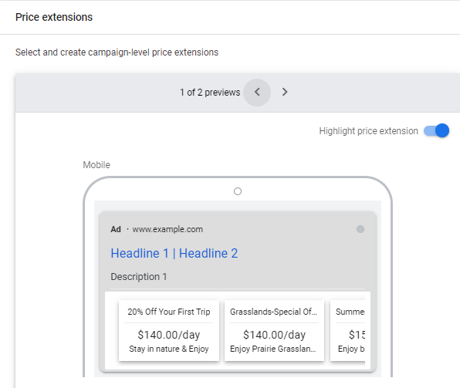
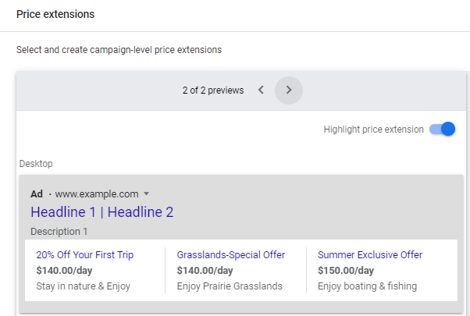
Ad Extensions in Advertisement (Cont.)
Price Extension
Mobile Preview
Desktop Preview

Slide 25
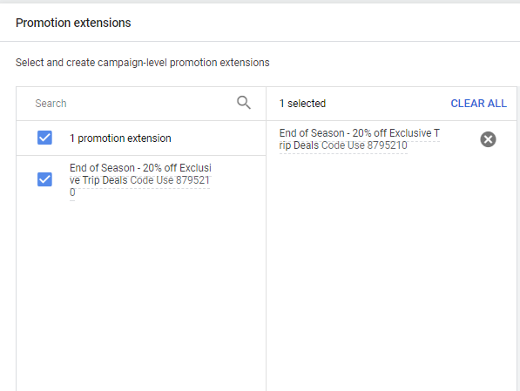
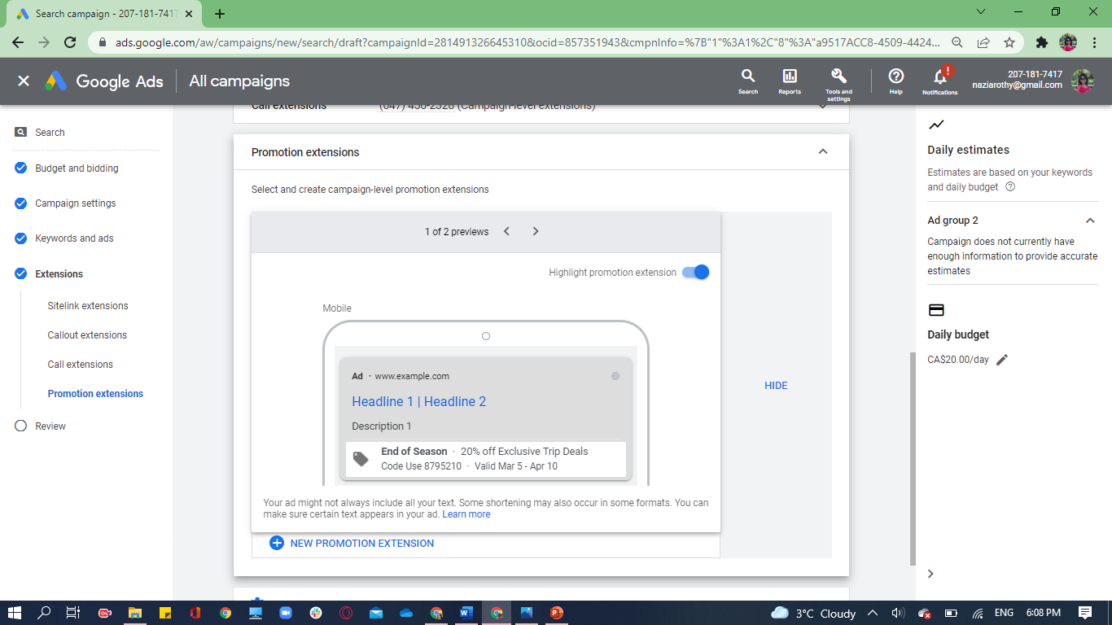
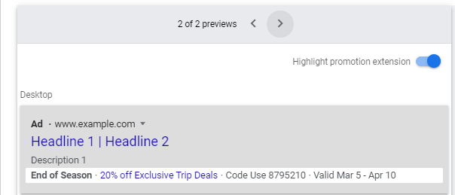
Ad Extensions in Advertisement (Cont.)
Promotion Extension
Mobile Preview
Desktop Preview

Slide 26
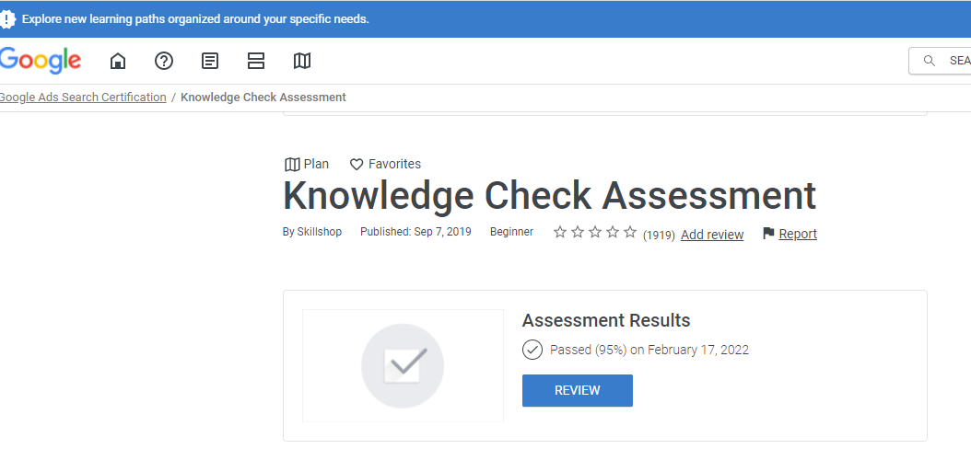
Assessment Report

Slide 27
Thank You

